Slide 1
Harvard Medical School
Harmful Brain Activity Classification
Kaggle Competition
S.W. Baek, D.K. Yoon
Feb 25th 2024
1

Slide 2
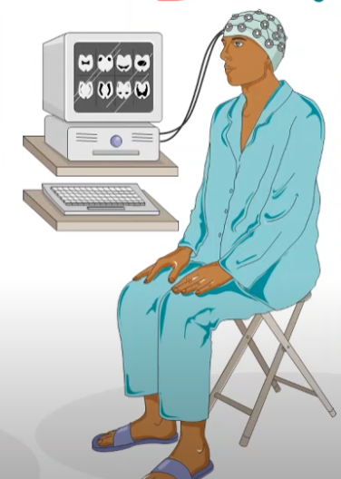
Electroencephalography (EEG) Definition
EEG is a method to record the macroscopic electrical activity by placing electrodes on the scalp
EEG recordings represent the activity of the surface layer of the brain underneath the scalp (Recording of brain activity)
Non-invasive test: small sensors are attached to the scalp to pick up the electrical signals produced by the brain
It can detect a population level neural activity
Kaggle Competition Slides
2

Slide 3
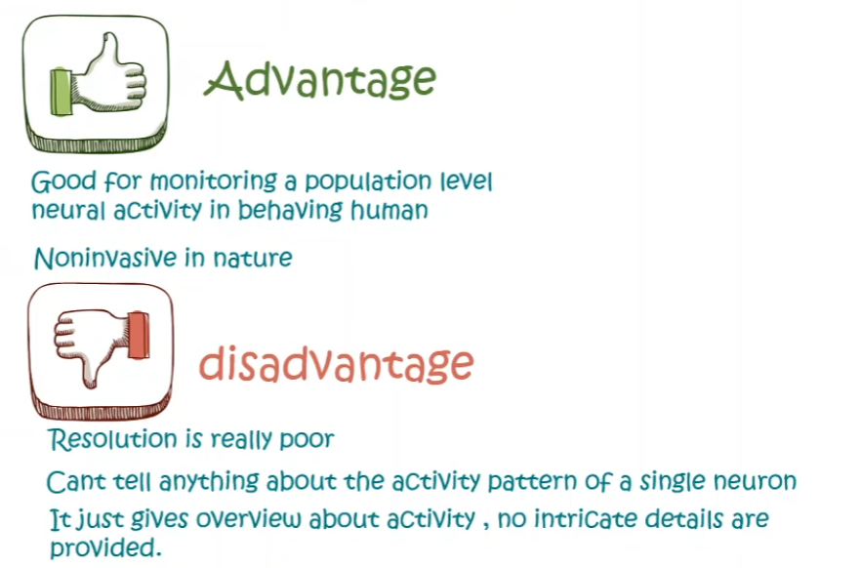
Pros and Cons of EEG
Kaggle Competition Slides
3

Slide 4
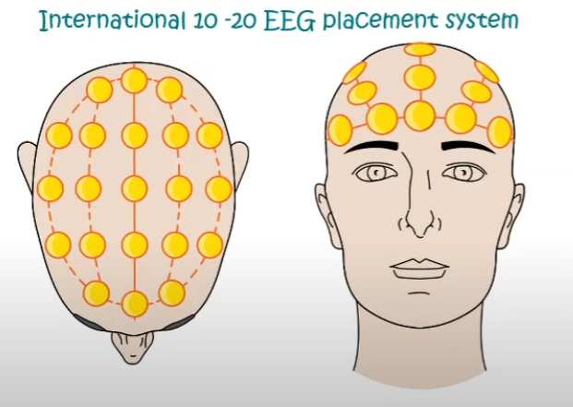
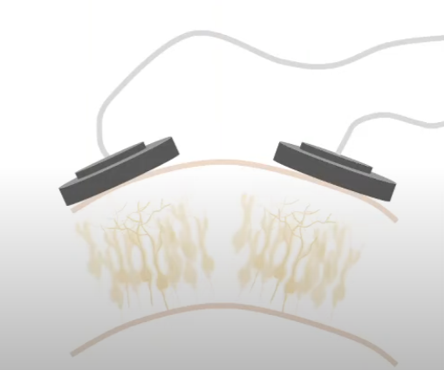
Locations of electrodes
Recorded waves forms reflect the cortical electrical activity
Signal intensity: measured in microvolts (mV)
Kaggle Competition Slides
4

Slide 5
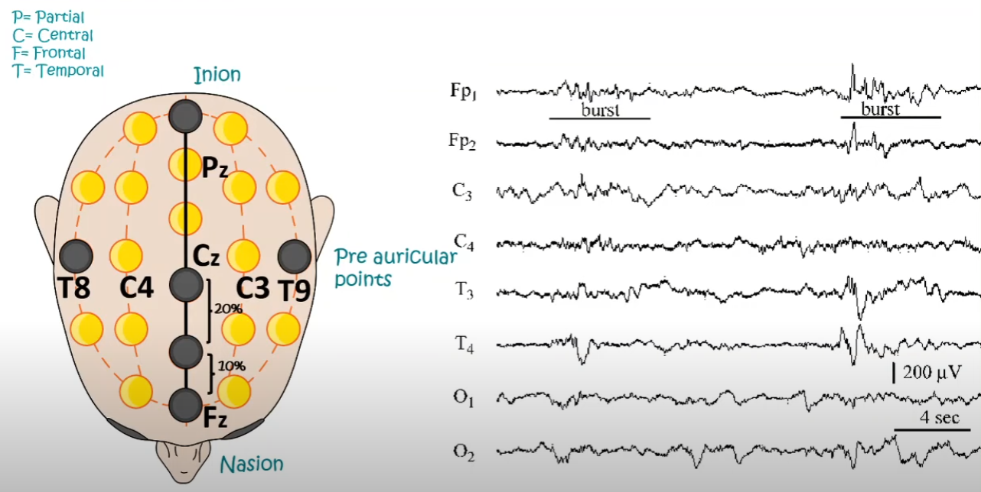
Location Terminology for EEG
Kaggle Competition Slides
5

Slide 6
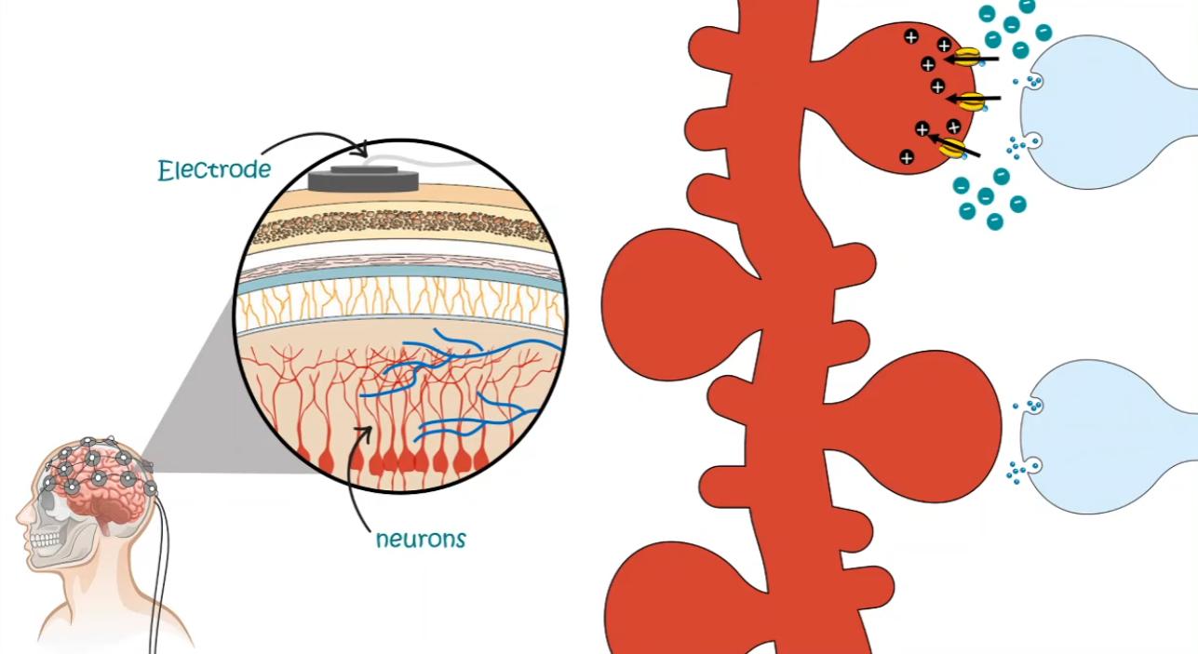
Location Terminology for EEG
EEG can detecft the + and – charges that add up around the neurons to detect its activity
Recording of voltage tracking overtime
Kaggle Competition Slides
6

Slide 7
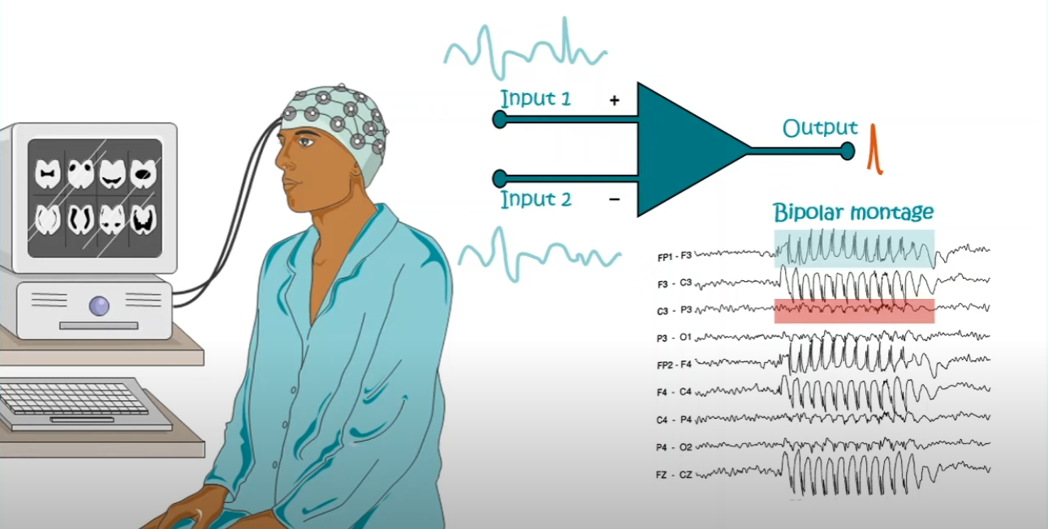
EEG - Differential Amplifier Machinery
Kaggle Competition Slides
7

Slide 8
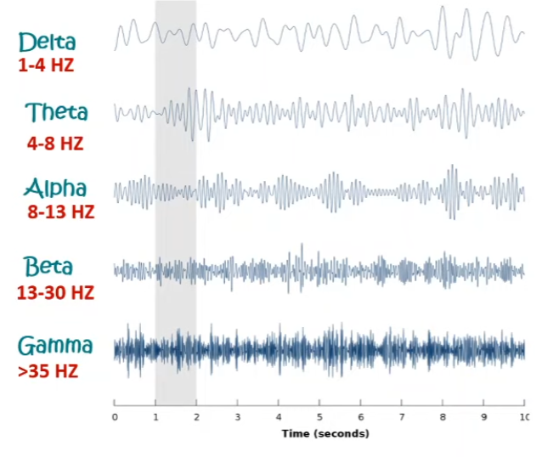
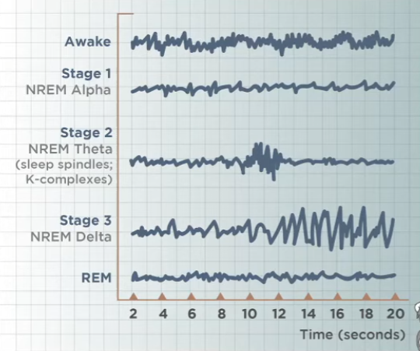
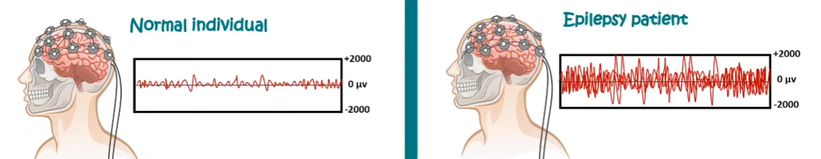
Signature EEG Waveforms
Kaggle Competition Slides
8

Slide 9
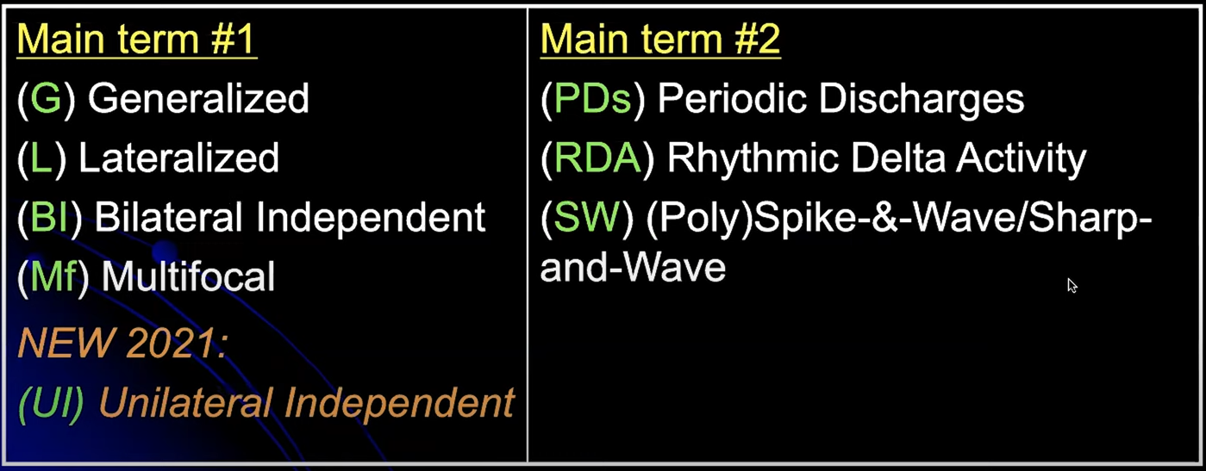
Main Terms for Rhythmic and Periodic Patterns
Kaggle Competition Slides
9

Slide 10
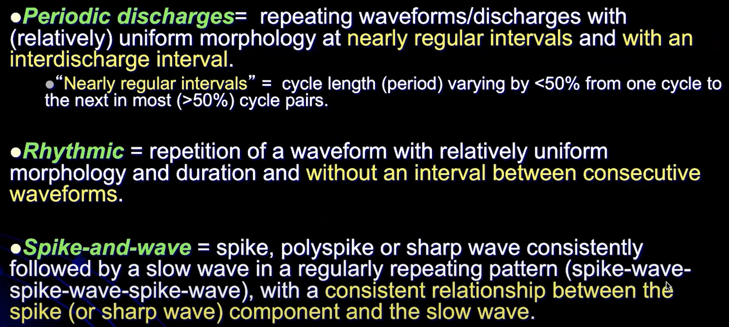
Main Terms for Rhythmic and Periodic Patterns
Kaggle Competition Slides
10

Slide 11
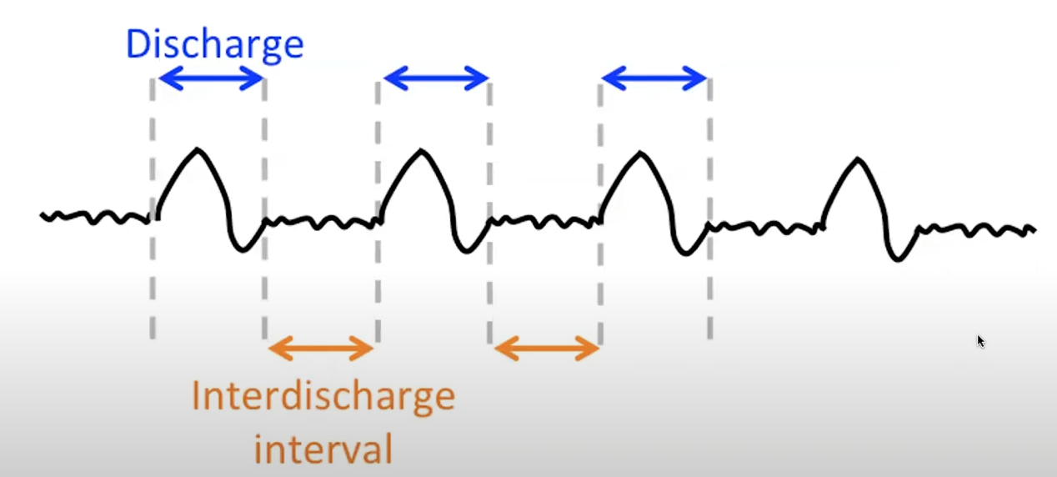
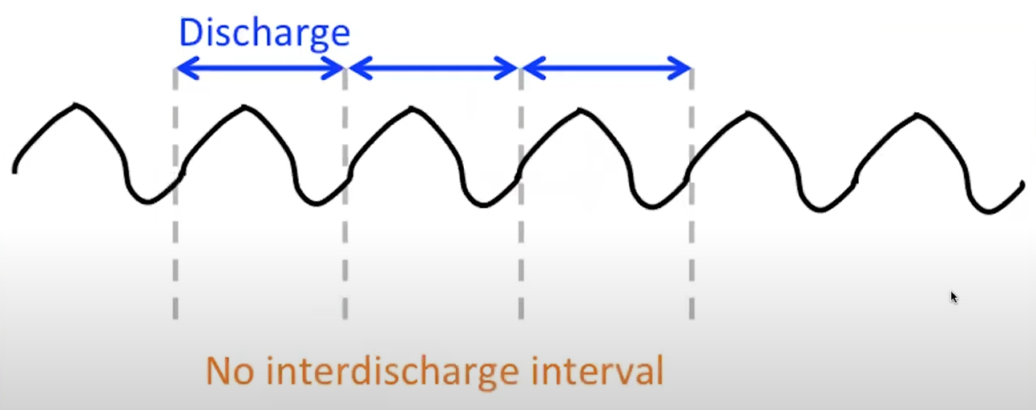
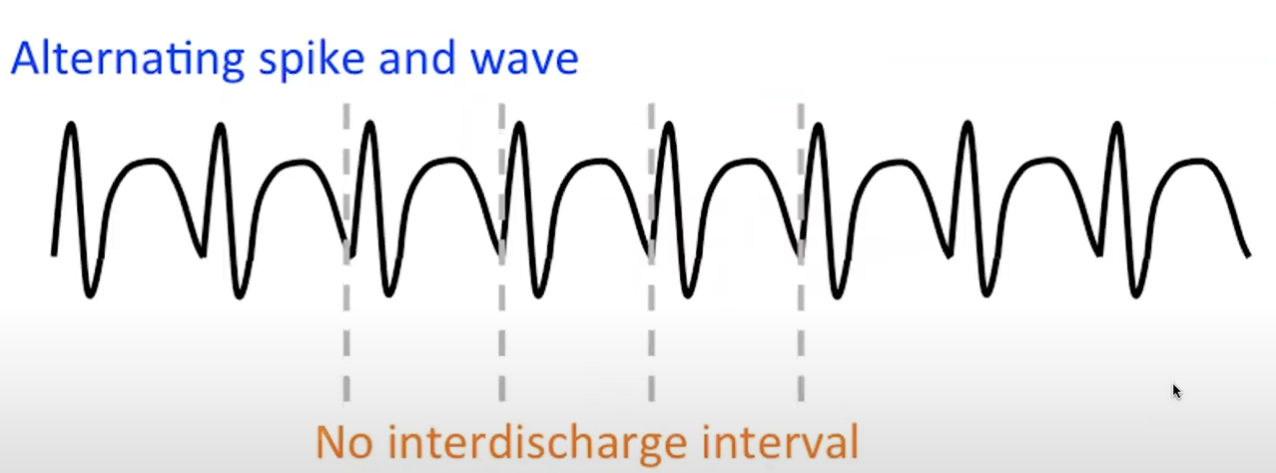
Examples of wave patterns (at least 6 times in a row)
Periodic
Rhythmic
Spike-and-wave
Kaggle Competition Slides
11

Slide 12
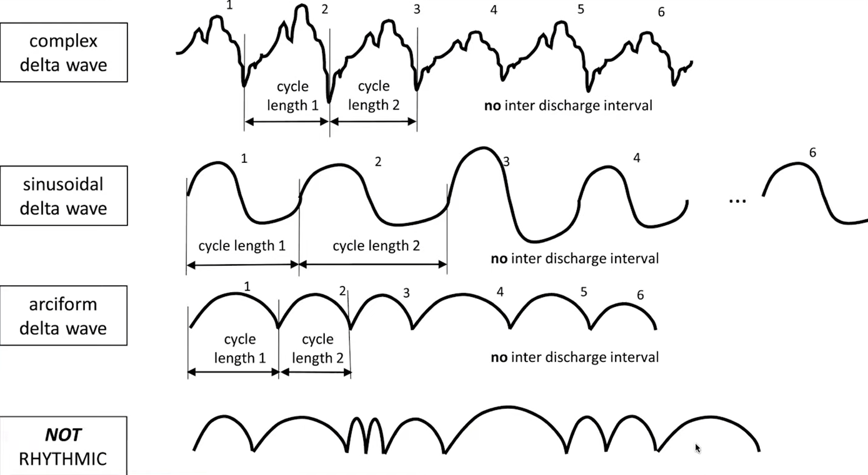
Rhythmic delta wave
*Polymorphic; irregular; arrhythmic
Kaggle Competition Slides
12

Slide 13
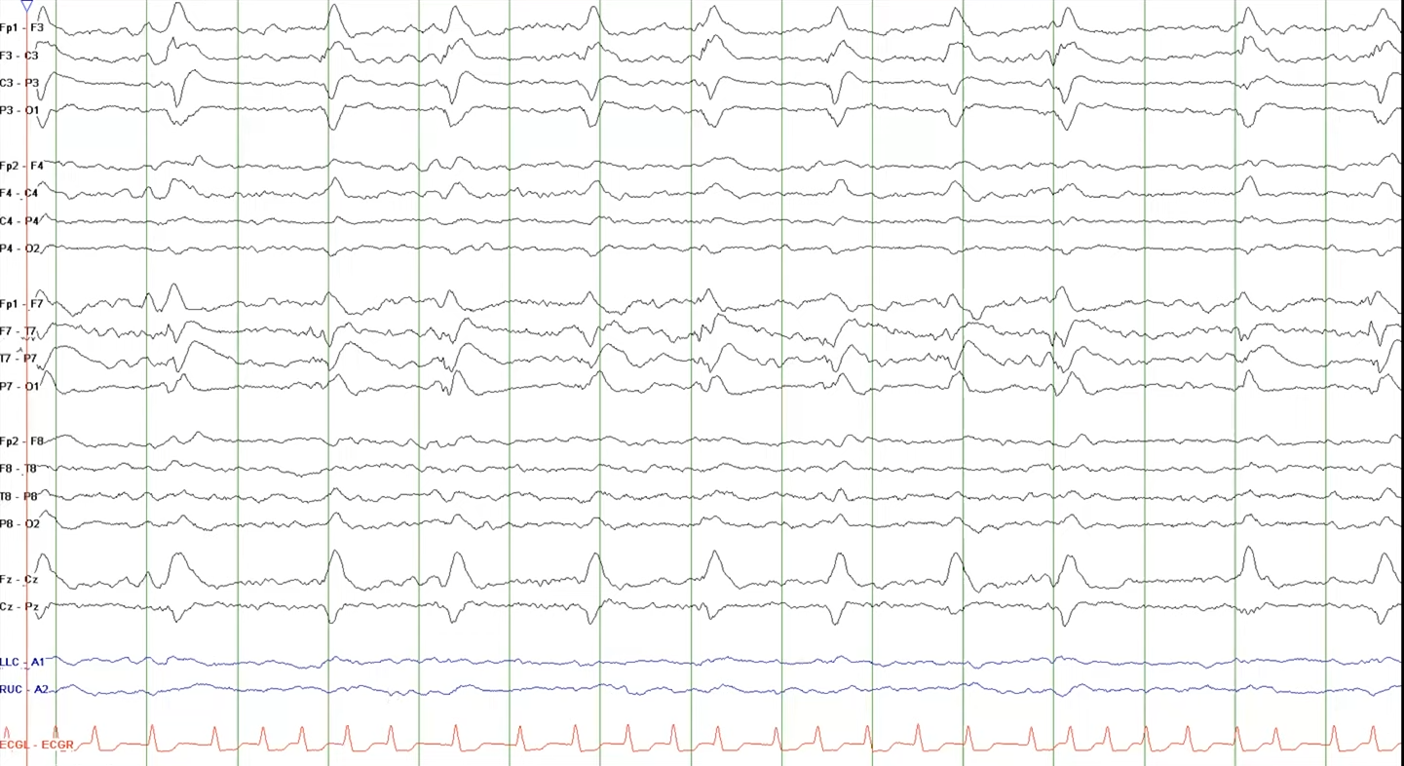
Lateral Periodic Discharges (LPDs)
Kaggle Competition Slides
13

Slide 14
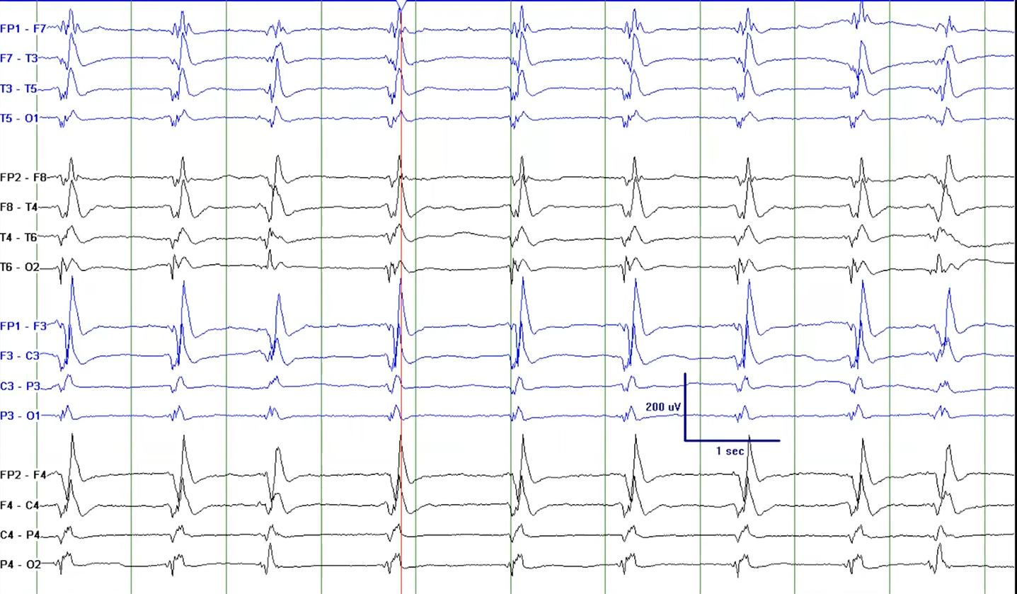
Generalized Periodic Discharges (GPDs)
Kaggle Competition Slides
14

Slide 15
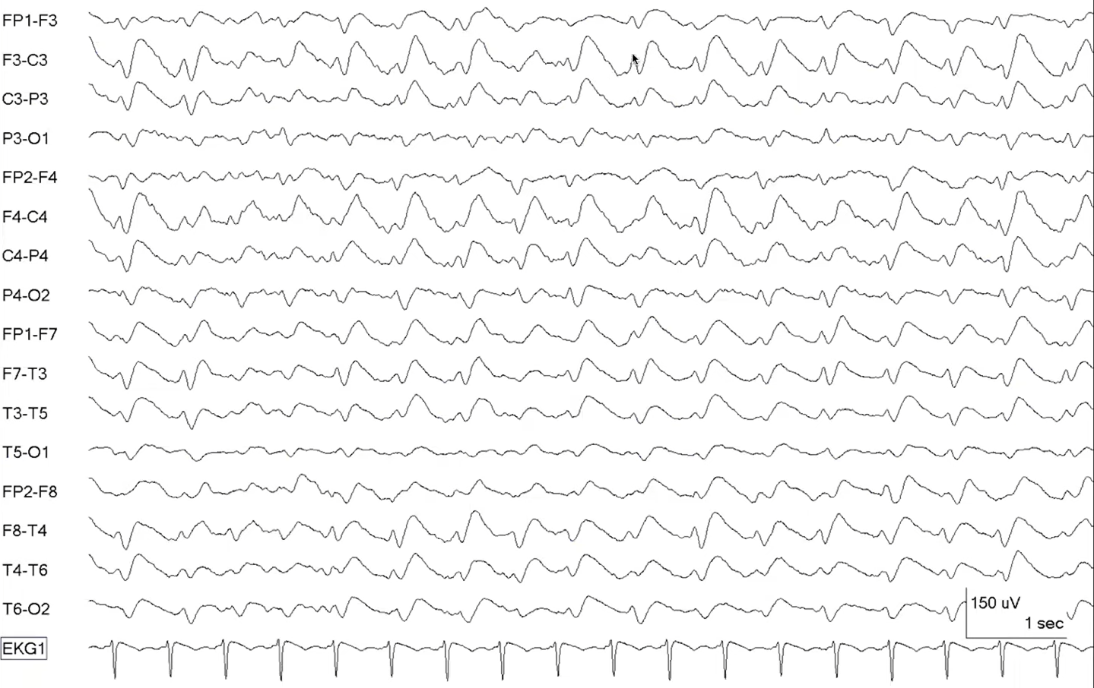
Generalized shape-and-wave (GSW)
Kaggle Competition Slides
15

Slide 16
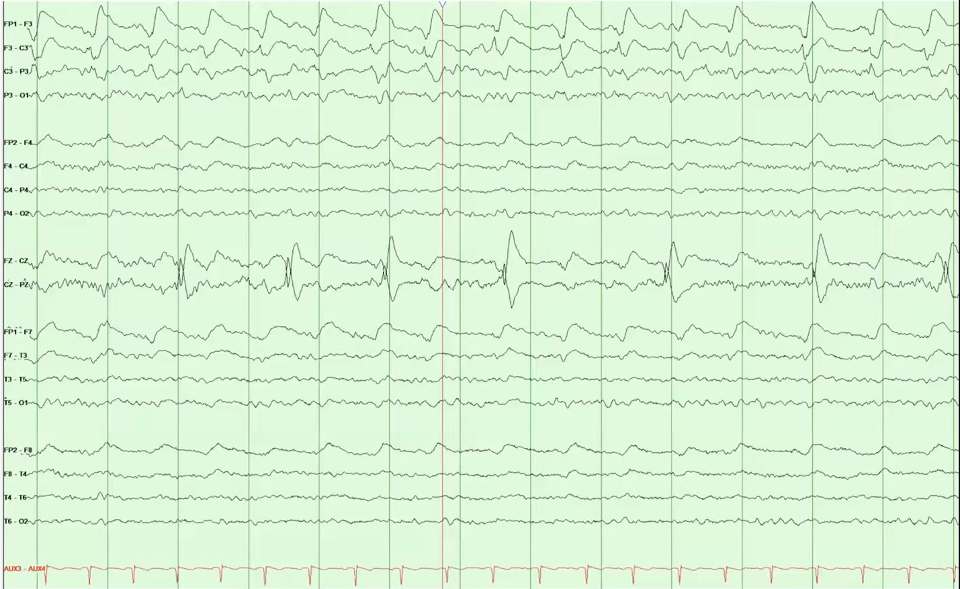
Unilateral Independent Periodic Discharges (UIPDs)
Kaggle Competition Slides
16

Slide 17
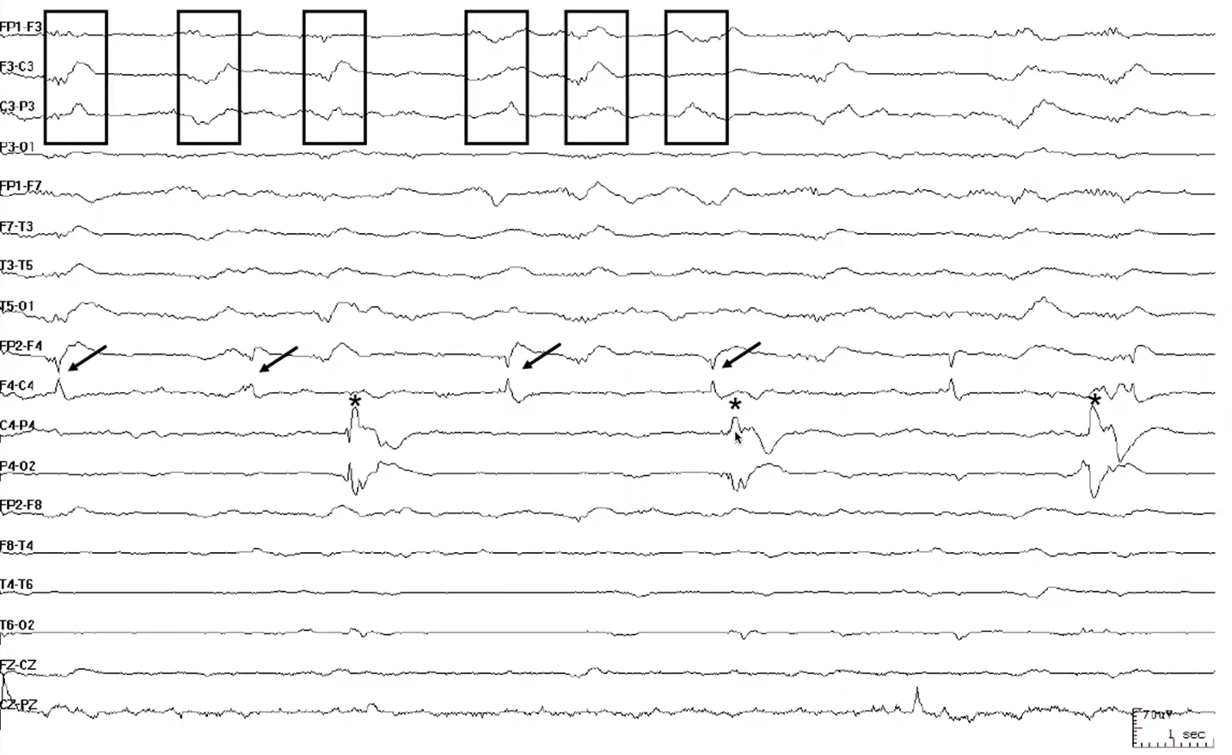
Multifocal Periodic Discharges (MPDs)
Kaggle Competition Slides
17

Slide 18
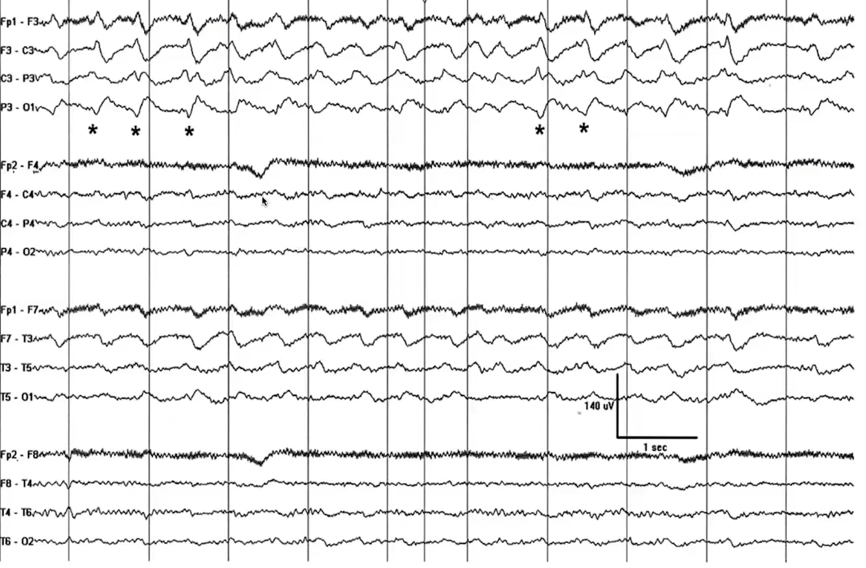
Lateralized Rhythmic Delta Activity (LRDA+S)
Kaggle Competition Slides
18

Slide 19
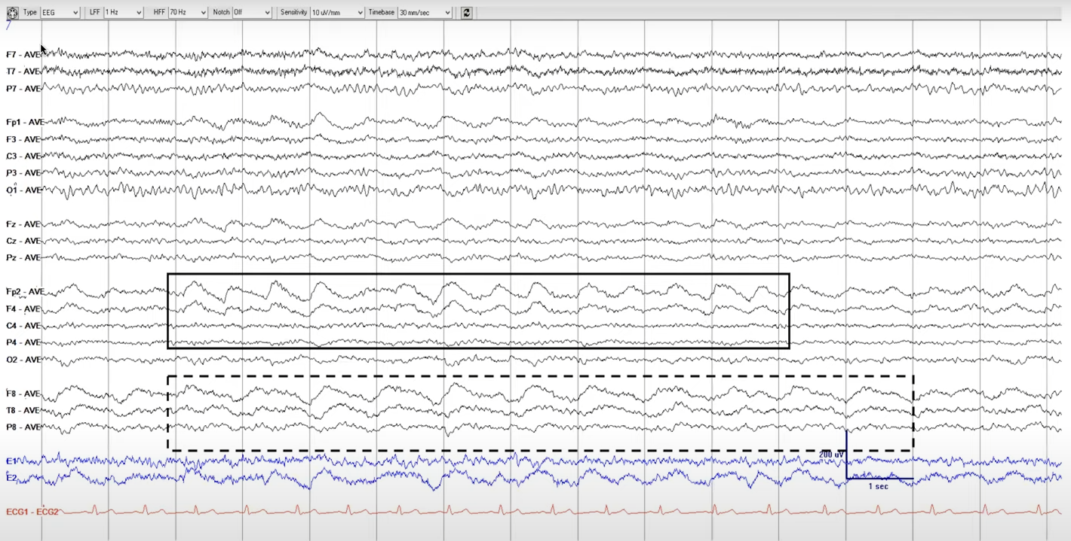
Unilateral Independent Rhythmic Delta Activity (UIRDA)
Kaggle Competition Slides
19

Slide 20
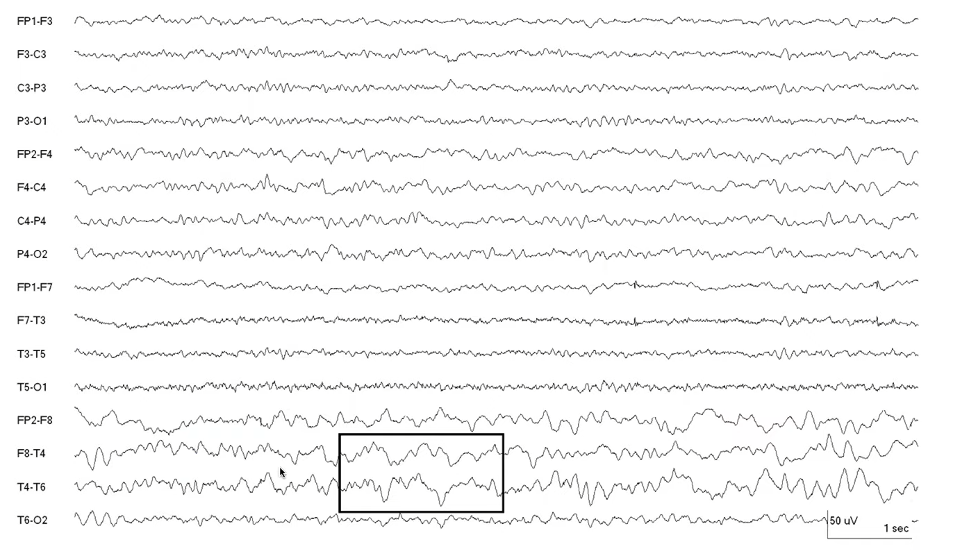
Polymorphic/arrhythmic
Kaggle Competition Slides
20

Slide 21
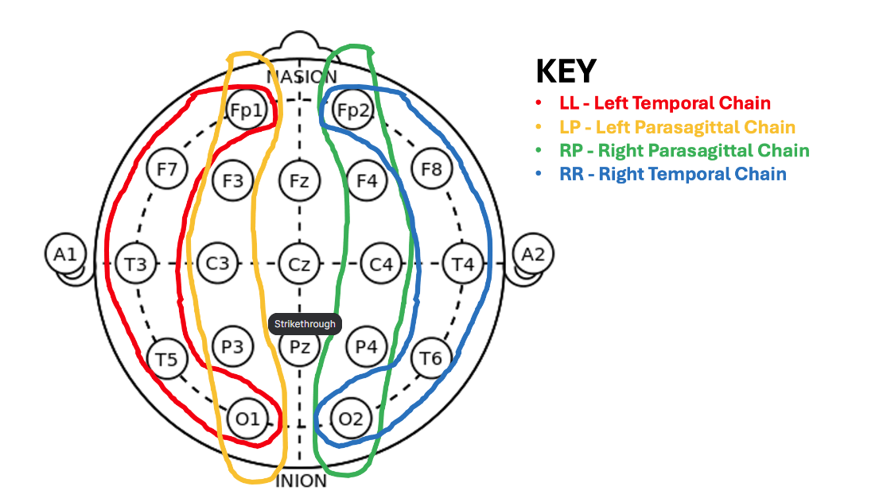
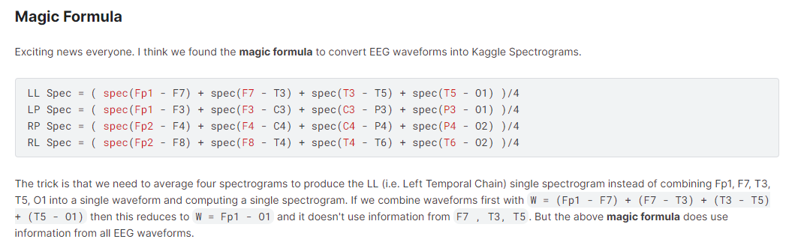
EEG to Spectograms
Kaggle Competition Slides
21

Slide 22
EfficientNet vs. CatBoost
EfficientNet B2 Starter (LB 0.43): https://www.kaggle.com/code/cdeotte/efficientnetb0-starter-lb-0-43?scriptVersionId=159911317
Catboost Start (LB 0.60): https://www.kaggle.com/competitions/hms-harmful-brain-activity-classification/discussion/467576
Kaggle Competition Slides
22

Slide 23
Thank you
Any Questions?
23

